Slide 1
FINAL pROJEct
Dinescu Denisa
2nd Year, Sgr. 3

Slide 2
Motivation:
Use-Case Description: Pet Shop Management System
Motivation for Choosing this Use-Case:
Real-world Relevance:
The use-case reflects real-world scenarios of handling various types of animals (dogs, fish), managing staff, and maintaining inventory.
Object-Oriented Design:
The use-case demonstrates fundamental principles of object-oriented design with classes and interfaces.
Different animal types are modeled as subclasses, promoting code reuse and extensibility.
Interfaces for Behavior:
The inclusion of interfaces (changeWater and needGroom) highlights the importance of defining common behaviors that different classes can implement.
Project Scope: The project scope includes developing the core functionalities of managing animals, staff, and inventory. It also involves implementing the changeWater and needGroom interfaces to showcase different interactions with animals.
Potential Extensions: Additional features can be added in the future, such as sales management, customer interactions, and integration with external databases for persistent data storage.

Slide 3
Project Structure:
Use-Case Overview: The use-case involves developing a Pet Shop Management System in Java. The system includes classes such as Animal, Store, Staff, Dog, Fish, and interfaces ChangeWater and needGroom. The objective is to create a software application that allows the management of a pet shop's inventory, staff, and the care of animals.
Interfaces:
needGroom Interface:
Represents the ability to groom animals.
changeWater Interface:
Represents the ability to change the water in aquariums or fish tanks.

Slide 4
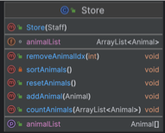
Classes
Store Class:
Represents the pet shop itself.
Animal Class:
Represents a generic animal in the pet shop.
Dog Class:
Extends Animal class.
Fish Class:
Extends Animal class.
Staff Class:
Represents a staff member
working in the pet shop.

Slide 5
Classes:
Everything database related:
Output:
Everything menu related:
Input:

Slide 6
Mid-term project requirments:

Slide 7
Lab 2 Homework:
Identify and implement 3 classes, A, B, C, such that class A has a String property and class B has a member of type A and another member of type array of C objects.
Implement and test constructors for each class.
Class A: Staff(String job, String name, int age)
public Staff(String job, String name, int age) { this.job = job; this.name = name; this.age = age;}
Class B: Store(Staff cashier, Animal[] animals)
public Store(Staff cashier, Animal[] animals) { this.cashier = cashier; this.animals = animals;}
Class C: Animal(String breed, int age, int weight)
public Animal(String breed, int age, int weight) { this.breed = breed; this.age = age; this.weight = weight;}

Slide 8
3. Write 2 functions that do representative work for your use case
In class Animal:
static int totalWeight(Animal[] animals){ int total = 0; for(Animal a : animals){ total += a.weight; } return total; }
In class Store:
public int countAnimals(Animal[] animals){ int total=0; for(Animal a : animals){ total += 1; } return total; }

Slide 9
4. Use program arguments to choose which function to call when the program is executed
public class Main { public static void main(String[] args) { Output outputDevice = new Output(); Input inputDevice = new Input(); Application app = new Application(inputDevice,outputDevice); app.run(); } }
public void run() { Scanner console = new Scanner(System.in); output.printMessageNl("\n PetShop Management System:"); output.printMessageNl("1. Start a new inventory"); output.printMessageNl("2. Continue with old inventory"); int input = console.nextInt(); switch (input){ case 1: newS(); break; case 2: oldS(); break; default: System.exit(1); } }

Slide 10
Lab 3 Homework
1. Identify similar behaviour between classes and add at least 2 interfaces, I, J, and 2 more classes,
D, E, to your project.
Interface I: needGroom
public interface needGroom { boolean dirty(); void groom(); }
Interface J: changeWater
public interface changeWater { boolean dirty(); void change(); }
Class D: Dog extends Animal
public Dog(String breed, int age, int weight) { super(breed, age, weight); }
Class E: Fish extends Animal
public Fish(String breed, int age, int weight) { super(breed, age, weight); }

Slide 11
3. Both D and E should implement either of I,J
2. At least one of the previously defined classes (A, B, C) should implement one of the newly
defined interfaces (I,J).
public class Animal implements needGroom, changeWater
public class Dog extends Animal implements needGroom{ private boolean dirty; @Override public boolean dirty() { return dirty; } @Override public void groom() { dirty = false; } }
public class Fish extends Animal implements changeWater{ private boolean water = true; @Override public boolean dirty() { return water; } @Override public void change() { water = false; } }

Slide 12
Lab 4 Homework
1. Make at least two of your classes implement the comparable interface.
public class Animal implements ..., Comparable<Animal>{
...
public int getWeight(){ return this.weight;} @Override public int compareTo(Animal o) { if (this.getWeight() == o.getWeight()) return 0; else if (this.getWeight() > o.getWeight()) return 1; else return -1; }
…
}
public class Staff implements Comparable<Staff>{ ... public int getAge(){ return this.age;} @Override public int compareTo(Staff o) { if (this.getAge() == o.getAge()) return 0; else if (this.getAge() > o.getAge()) return 1; else return -1; } }

Slide 13
2. Add functionality to your program to sort and group objects from your use case. This should be reflected in at least 3 functions.
public List<Animal> heavierThan3kg() { List<Animal> animals = Input.readAnimal(); List<Animal> Sorted = new ArrayList<>(); for(Animal animal : animals ){ if(animal.getWeight() > 3000) Sorted.add(animal); } return Sorted; }
public void sortByWeight(){ List<Animal> animals = input.readAnimalsFromFile(); animals.sort(Comparator.comparing(Animal::getWeight)); }
public Map<Animal, Integer> groupByBreed(ArrayList<Animal> animals) { Map<Animal, Integer> animalMap = new HashMap<>(); for(Animal animal : animals ){ if(animalMap.containsKey(animal)){ animalMap.put(animal, animalMap.get(animal) + 1); }else { animalMap.put(animal, 1); } } return animalMap; }

Slide 14
Lab 5 Homework
1. Use files to store the state of your application (data). To know if you should start the app from
scratch or continue a previous one, you can use a program argument, or ask the user for input.
public void run() { Scanner console = new Scanner(System.in); output.printMessageNl("\n PetShop Management System:"); output.printMessageNl("1. Start a new inventory"); output.printMessageNl("2. Continue with old inventory"); int input = console.nextInt(); switch (input){ case 1: newS(); break; case 2: oldS(); break; default: System.exit(1); } }

Slide 15
2. Use system input to prompt the user to introduce data into your application
Scanner console = new Scanner(System.in); output.printMessageNl(" Menu"); output.printMessageNl("1. Add animal"); output.printMessageNl("2. Remove animal"); output.printMessageNl("3. Print store"); output.printMessageNl("4. Compute total weight of animals"); output.printMessageNl("5. Count animals"); output.printMessageNl("6. Group animals by breed"); output.printMessageNl("7. Exit"); int in = console.nextInt(); while(in != 0) { switch (in) { case 1: ArrayList<Animal> newAnimal = input.getRandomAnimal(1); animals.addAll(newAnimal); store.setAnimalList(animals); break; case 2: int randomIndex = input.nextInt(0, store.getAnimalList().length - 1); output.printMessageNl("Removing animal with index " + (randomIndex + 1)); store.removeAnimalIdx(randomIndex); output.printMessageNl(""); break;
case 3: output.printStore(store); break; case 4: animal.totalWeight(animals); break; case 5: store.countAnimals(animals); break; case 6: animal.groupByBreed(animals); break; case 7: System.exit(0); break; } }

Slide 16
3. Create an exception class, that can be thrown when the functionality of the application reaches an exceptional state (situation). For example, an object with the same name exists in the program already. When this exception is encountered, the program should handle the situation and have a backup plan for the user.
public class InvalidPersonAge extends Throwable { public InvalidPersonAge(String message){ super(message); } }
public void checkAge() throws InvalidPersonAge{ if(this.age < 18) throw new InvalidPersonAge("Invalid age"); }
public class InvalidAnimalWeight extends Throwable{ public InvalidAnimalWeight(String message){ super(message); } }
public void checkWeight() throws InvalidAnimalWeight { if(this.weight > 7000) throw new InvalidAnimalWeight("Invalid weight"); }

Slide 17
Final project requirments:

Slide 18
Create at least one test case (unit test) for each constructor and at least 3 test cases that check functionality.
Unit test for Animal constructor
Unit test for Store constructor
import org.junit.jupiter.api.Test; import static org.junit.jupiter.api.Assertions.*; class AnimalTest { @Test public void testAnimalConstructor() { Animal animal = new Animal("Labrador", 200, 3, 5000); assertEquals("Labrador", animal.AnimalBreed); assertEquals(200, animal.getPrice()); assertEquals(3, animal.getAge()); assertEquals(5000, animal.getWeight()); assertFalse(animal.dirtyWater()); assertFalse(animal.dirty()); animal.groom(); assertTrue(animal.dirty()); animal.change(); assertTrue(animal.dirtyWater()); } }
import org.junit.jupiter.api.Test; import static org.junit.jupiter.api.Assertions.assertEquals; import static org.junit.jupiter.api.Assertions.assertNotNull; class StoreTest { @Test public void testStoreConstructor() { Staff staff = new Staff("John", "manager", 30); Store store = new Store(staff); assertEquals(staff, store.staff1); Animal[] animalArray = store.getAnimalList(); assertNotNull(animalArray); assertEquals(0, animalArray.length); store.resetAnimals(); assertEquals(0, store.getAnimalList().length); } }

Slide 19
Unit test for Fish constructor
import org.junit.jupiter.api.Test; import static org.junit.jupiter.api.Assertions.*;
class FishTest { @Test public void testFishConstructor() { Fish fish = new Fish(Fish.Breed.ClownFish.name(), 50, 1, 200); assertEquals("ClownFish", fish.AnimalBreed); assertEquals(50, fish.getPrice()); assertEquals(1, fish.getAge()); assertEquals(200, fish.getWeight()); assertFalse(fish.dirtyWater()); fish.change(); assertTrue(fish.dirtyWater()); } }
Unit test for Dog constructor
import org.junit.jupiter.api.Test; import static org.junit.jupiter.api.Assertions.*; class DogTest { @Test public void testDogConstructor() { Dog dog = new Dog(Dog.Breed.Labrador.name(), 200, 3, 5000); assertEquals("Labrador", dog.AnimalBreed); assertEquals(200, dog.getPrice()); assertEquals(3, dog.getAge()); assertEquals(5000, dog.getWeight()); assertTrue(dog.dirty()); dog.groom(); assertFalse(dog.dirty()); } }

Slide 20
Unit test for Staff constructor
Unit test for GroupByBreed method
import org.junit.jupiter.api.Test; import static org.junit.jupiter.api.Assertions.assertEquals; import static org.junit.jupiter.api.Assertions.fail; class StaffTest { @Test public void testStaffConstructor() { Staff staff = new Staff("John", "manager", 30); assertEquals("John", staff.name); assertEquals("manager", staff.job); assertEquals(30, staff.getAge()); Staff youngerStaff = new Staff("Alice", "assistant", 25); Staff olderStaff = new Staff("Bob", "supervisor", 35); assertEquals(1, olderStaff.compareTo(staff)); assertEquals(-1, youngerStaff.compareTo(staff)); assertEquals(0, staff.compareTo(staff)); try { staff.checkAge(); } catch (InvalidPersonAge e) { fail("Unexpected InvalidPersonAge exception for a valid age"); } }
}
import org.junit.jupiter.api.Test; import java.util.ArrayList; import java.util.Map; import static org.junit.jupiter.api.Assertions.assertEquals;
public class AnimalBreedTest { @Test public void testGroupByBreed() { Animal animal1 = new Animal("Dog", 150, 3, 5000); Animal animal2 = new Animal("Cat", 120, 2, 3000); Animal animal3 = new Animal("Dog", 200, 4, 6000); Animal animal4 = new Animal("Fish", 80, 1, 1000); ArrayList<Animal> animals = new ArrayList<>(); animals.add(animal1); animals.add(animal2); animals.add(animal3); animals.add(animal4); Map<String, Integer> result = Animal.groupByBreed(animals); assertEquals(2, result.get("Dog")); assertEquals(1, result.get("Cat")); assertEquals(1, result.get("Fish")); assertEquals(3, result.size()); } }

Slide 21
Unit test for countAnimals method
import org.junit.jupiter.api.Test; import java.util.ArrayList; class countAnimalsTest { @Test public void testCountAnimals() { Staff staff = new Staff("John", "manager", 30); Store store = new Store(staff); ArrayList<Animal> animals = new ArrayList<>(); animals.add(new Animal("Labrador", 200, 3, 5000)); animals.add(new Animal("ClownFish", 50, 1, 200)); store.countAnimals(animals); } }
Unit test for HavierThan3kg method
import org.junit.Test; import java.util.ArrayList; import java.util.List; import static org.junit.Assert.assertEquals; public class HeavierThan3KGTest { @Test public void testHeavierThan3kg() { List<Animal> animals = new ArrayList<>(); animals.add(new Animal("Dog", 200, 2, 5000)); animals.add(new Animal("Cat", 150, 3, 2000)); animals.add(new Animal("Fish", 100, 1, 4000)); Animal animal = new Animal(); List<Animal> result = animal.heavierThan3kg(animals); assertEquals(2, result.size()); for (Animal a : result) { assertEquals(true, a.getWeight() > 3000); } }
}

Slide 22
public static void main(String[] args) { Application application = new Application(new Input(), new Output()); if (args.length > 0) { if (args[0].equals("customer")) { application.customerMenu(); } else if (args[0].equals("admin")) { application.adminMenu(args); } } else { Scanner console = new Scanner(System.in); int userInput = application.getUserInput(console, 1, 2); switch (userInput) { case 1: new Thread(() -> application.customerMenu()).start(); break; case 2: new Thread(() -> application.adminMenu(args)).start(); break; default: System.exit(1); } }
Use threads to accelerate processing.
private class newSThread extends Thread { @Override public void run() { newS(); } } private class oldSThread extends Thread { @Override public void run() { oldS(); } }

Slide 23
Create a connection with the database, query data and show it on screen (or UI).
public void printDB() { try { Connection connection = DriverManager.getConnection(JDBC_URL, username, password); String sqlQuery = "select * from animals order by animaltype, animalbreed"; PreparedStatement preparedStatement = connection.prepareStatement(sqlQuery); ResultSet resultSet = preparedStatement.executeQuery(); output.printMessageNl("\n Available animals:"); int i = 1; while (resultSet.next()) { String animalType = resultSet.getString("animaltype"); String animalBreed = resultSet.getString("animalbreed"); int animalPrice = resultSet.getInt("animalprice"); int animalAge = resultSet.getInt("animalage"); int animalWeight = resultSet.getInt("animalweight"); output.printMessageNl(i++ + ". " + animalBreed + ":\n- price " + animalPrice + "\n- age " + animalAge + "\n- weight "
+ animalWeight + "\n- " + animalType + "\n"); } } catch (Exception e) { e.printStackTrace(); } }

Slide 24
Insert or update data into the DB tables.
public ArrayList<Animal> storeDB() { ArrayList<Animal> animalList = new ArrayList<>(); try { Connection connection = DriverManager.getConnection(JDBC_URL, username, password); String sqlQuery = "select * from animals"; PreparedStatement preparedStatement = connection.prepareStatement(sqlQuery); ResultSet resultSet = preparedStatement.executeQuery(); while (resultSet.next()) { String animalType = resultSet.getString("animaltype"); String animalBreed = resultSet.getString("animalbreed"); int animalPrice = resultSet.getInt("animalprice"); int animalAge = resultSet.getInt("animalage"); int animalWeight = resultSet.getInt("animalweight"); Animal animal = new Animal(animalBreed, animalPrice, animalAge, animalWeight); animalList.add(animal); } } catch (Exception e) { e.printStackTrace(); } return animalList; }

Slide 25
Manage users or roles for different access levels to the DB.
public void run(String[] args) { if(args.length > 0){ if( args[0].equals("customer")){ customerMenu(); } else if(args[0].equals("admin")){ adminMenu(args); } } else { output.printMessageNl("\n\t\t\t PetShop Management System:"); output.printMessageNl("1. Customer"); output.printMessageNl("2. Admin"); Scanner console = new Scanner(System.in); int userInput = getUserInput(console, 1, 2); switch (userInput) { case 1: customerMenu(); break; case 2: adminMenu(args); break; default: System.exit(1); } } }

Slide 26
public void adminMenu(String[] args){ Scanner console = new Scanner(System.in); int userInput; if(args.length > 1){ if( args[1].equals("old")){ oldS(); } else if(args[1].equals("new")){ newS(); } } else do{ output.printMessageNl("\n Admin Management System:"); output.printMessageNl("1. Create new inverntory"); output.printMessageNl("2. Load old inventory"); userInput = getUserInput(console, 1, 2); switch (userInput) { case 1: newS(); break; case 2: oldS(); break; default: System.exit(1); } } while(userInput != 0);
}
private void customerMenu() { Scanner console = new Scanner(System.in); int userInput; do { output.printMessageNl("\n Customer Menu:"); output.printMessageNl("1. View inventory"); output.printMessageNl("2. Buy animal"); output.printMessageNl("3. Return animal"); output.printMessageNl("4. Exit"); userInput = getUserInput(console, 1, 3); switch (userInput) { case 1: database.printDB(); break; case 2: database.buyAnimal(); break; case 3: database.returnAnimal(); break; case 4: System.exit(1); } }while(userInput != 0); }

Slide 27
Validate input data before interacting with the DB. Use traditional validation or prepared .
public Animal createAnimal() { Scanner scanner = new Scanner(System.in); output.printMessageNl("\n Choose the type of animal:"); output.printMessageNl("1. Dog"); output.printMessageNl("2. Fish"); int animalType = getUserInput(scanner, "\n Enter your choice (1 or 2): ", 1, 2); String animalBreed; if (animalType == 1) { output.printMessage("\n Enter dog breed (Rottweiller, Golden, Bischon, Husky, Samoyed, Yorkshire, Labrador): "); while (true) { animalBreed = scanner.nextLine().trim(); output.printMessageNl(animalBreed); try { if (isValidDogBreed(animalBreed)) { break; }

Slide 28
else { output.printMessage("\n Invalid breed. Please enter a valid dog breed: "); } } catch (IllegalArgumentException e) { output.printMessage("\n Invalid breed. Please enter a valid dog breed: "); } } } else { output.printMessage("\n Enter fish breed (ClownFish, Koi, GoldenFish, BubbleEye, Ryukin):"); while (true) { animalBreed = scanner.nextLine().trim(); try { if (isValidFishBreed(animalBreed)) { break; } else { output.printMessage("\n Invalid breed. Please enter a valid fish breed: "); } } catch (IllegalArgumentException e) { output.printMessage("\n Invalid breed. Please enter a valid fish breed: "); } } } int price = getUserInput(scanner, "Enter price (must be greater than 100): ", 101); int age = getUserInput(scanner, "Enter age (must be between 0 and 20): ", 0, 20); int weight = getUserInput(scanner, "Enter weight: "); Animal newAnimal = new Animal(animalBreed, price, age, weight); return newAnimal; }

Slide 29
public int getUserInput(Scanner scanner, String prompt, int... validRange) { int userInput; do { output.printMessage(prompt); while (!scanner.hasNextInt()) { output.printMessageNl("Invalid input. Please enter a valid number."); scanner.next(); // consume the invalid input } userInput = scanner.nextInt(); if (validRange.length == 0) { break; // No range validation needed } if (validRange.length == 1 && userInput >= validRange[0]) { break; // Validate against minimum value } if (validRange.length == 2 && userInput >= validRange[0] && userInput <= validRange[1]) { break; // Validate against range } output.printMessageNl("Invalid input. Please enter a valid number."); } while (true); scanner.nextLine(); return userInput; }

Slide 30
public boolean isValidDogBreed(String breed) { try { Dog.Breed.valueOf(breed); return true; } catch (IllegalArgumentException e) { return false; } }
public boolean isValidFishBreed(String breed) { try { Fish.Breed.valueOf(breed); return true; } catch (IllegalArgumentException e) { return false; } }

Slide 31
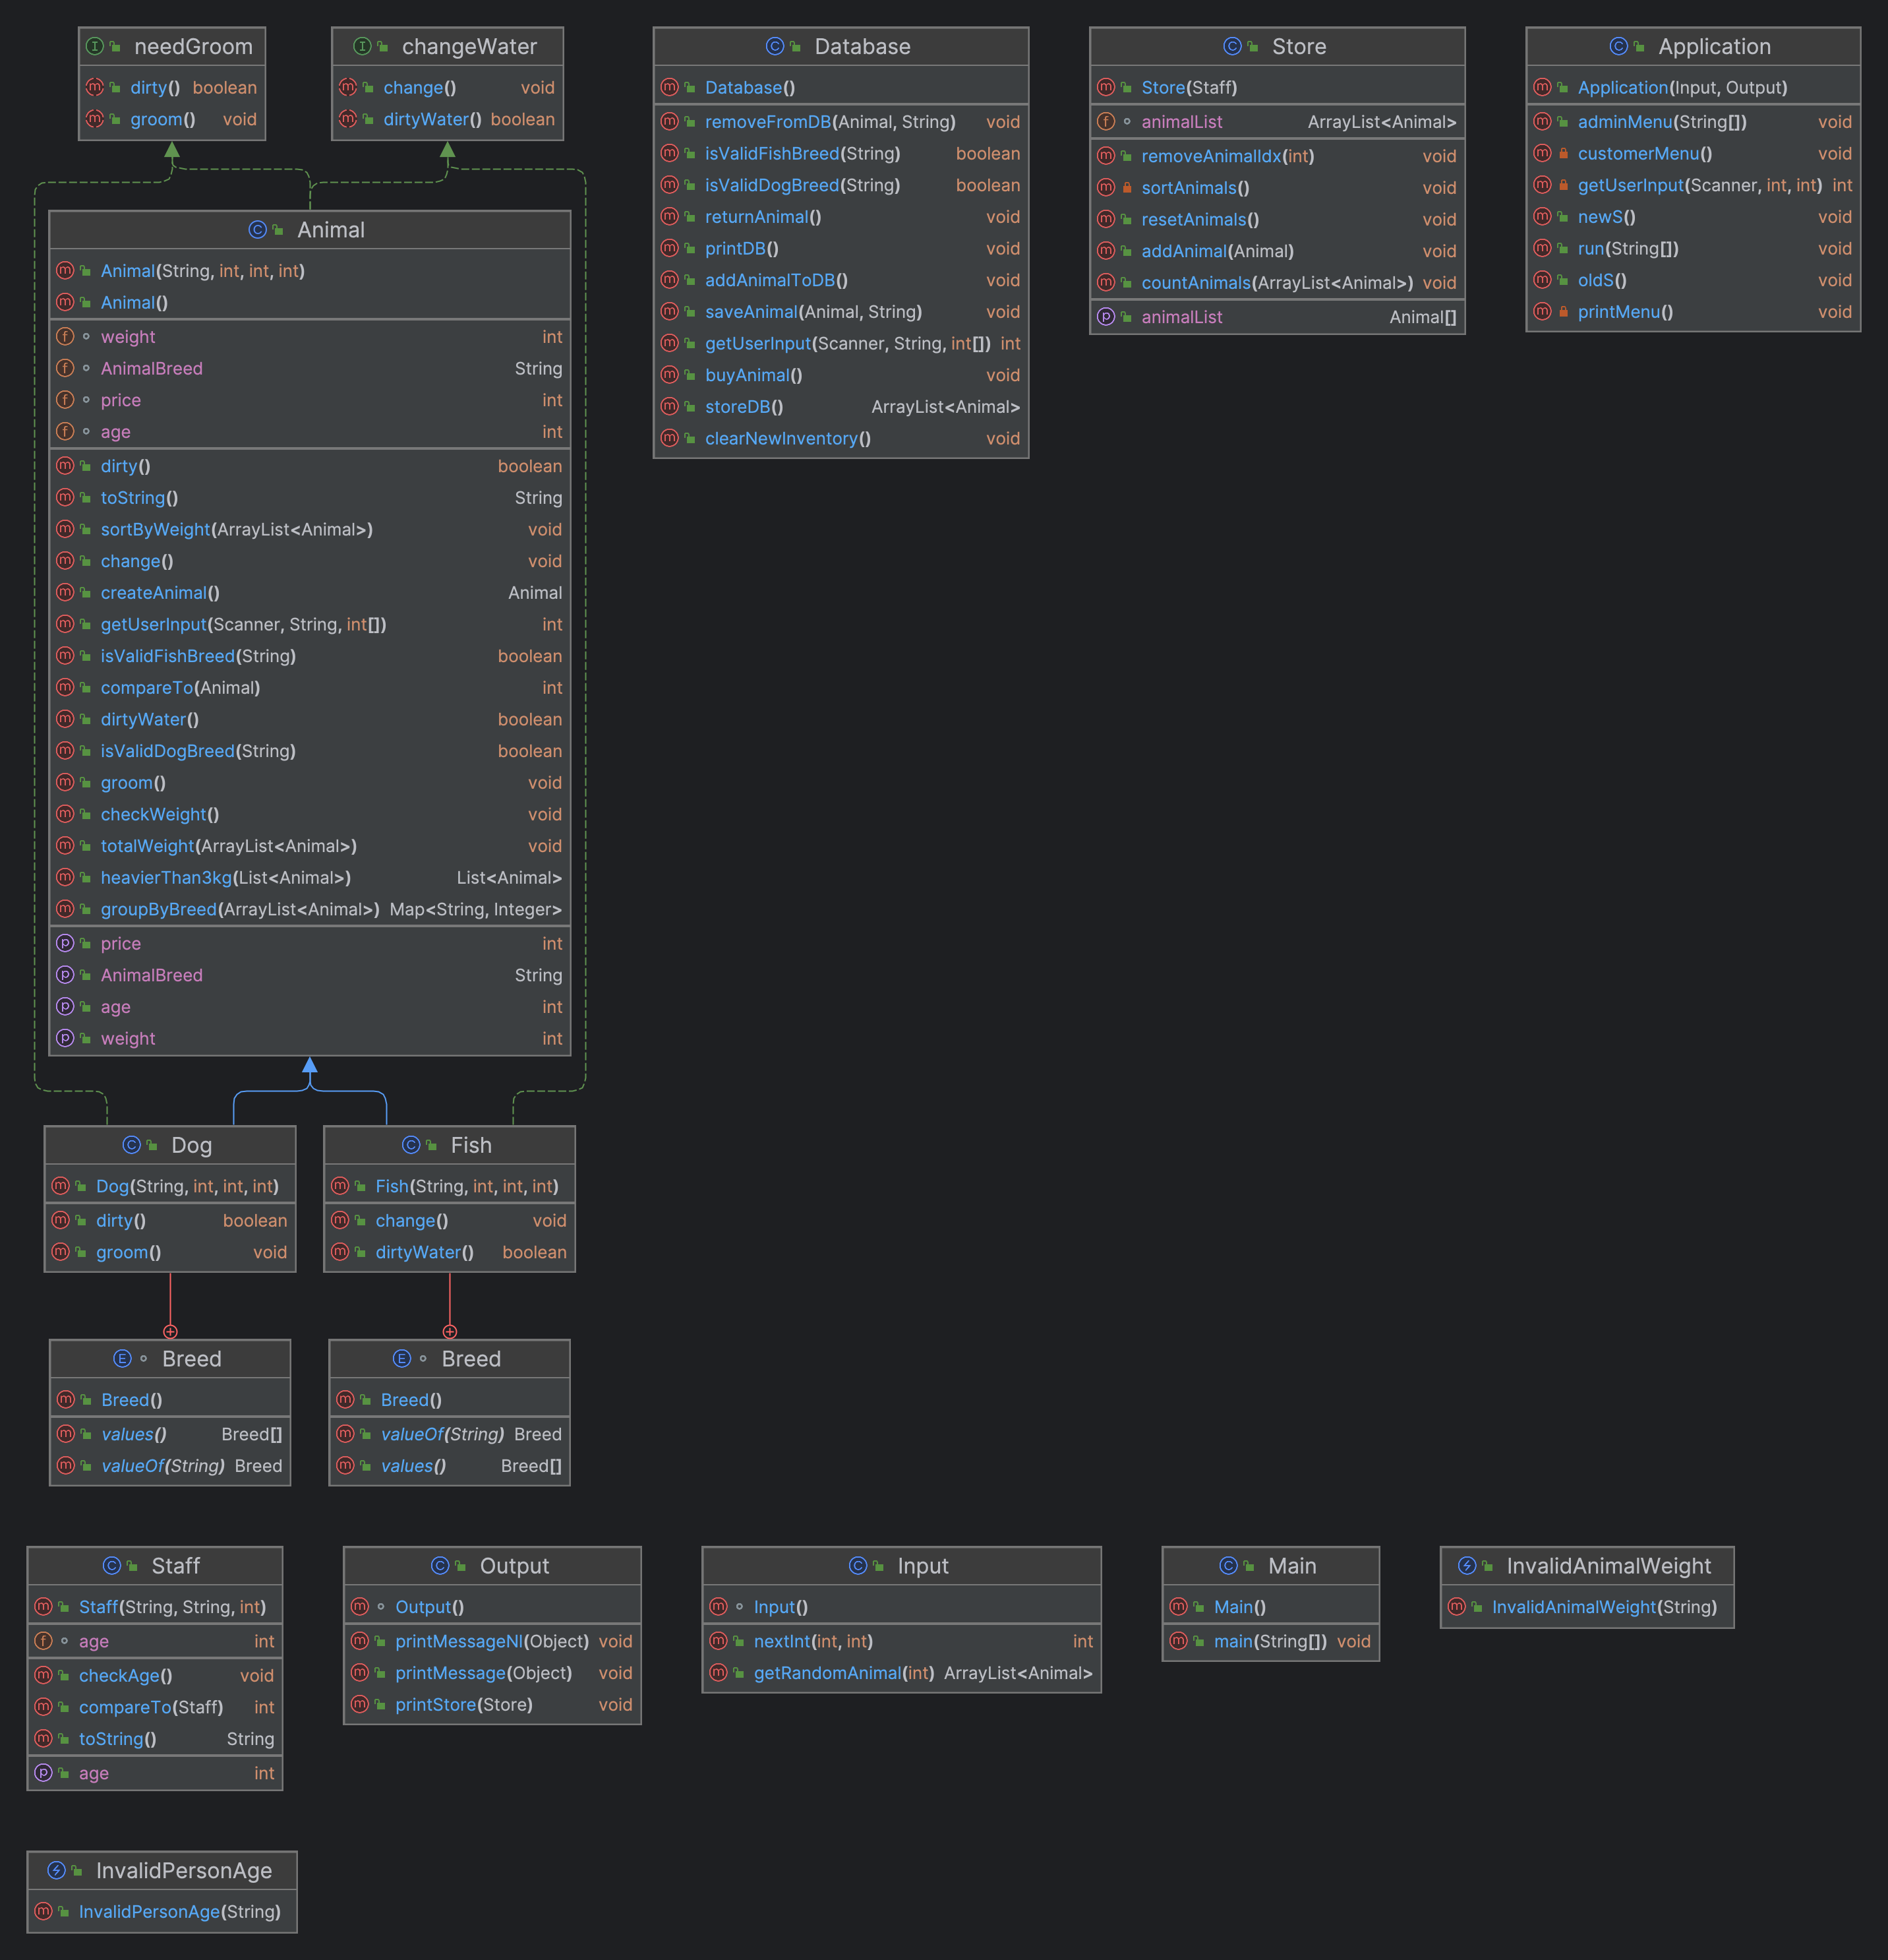
Project Diagram:

